Slide 1
Medlytics Week 1 Topic 2
Predictors and Classifiers
July 8 2020
Notes:
1
1
Check distro statement before using:
DISTRIBUTION STATEMENT A. Approved for pubic release: distribution is unlimited.
This material is based upon work supported under Air Force Contract No. FA8721-05-C-0002 and/or FA8702-15-D-0001. Any opinions, findings, conclusions or recommendations expressed in this material are those of the author(s) and do not necessarily reflect the views of the U.S. Air Force.
© 2020 Massachusetts Institute of Technology.
Delivered to the U.S. Government with Unlimited Rights, as defined in DFARS Part 252.227-7013 or 7014 (Feb 2014). Notwithstanding any copyright notice, U.S. Government rights in this work are defined by DFARS 252.227-7013 or DFARS 252.227-7014 as detailed above. Use of this work other than as specifically authorized by the U.S. Government may violate any copyrights that exist in this work.

Slide 2
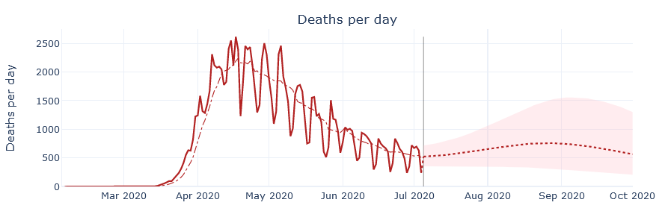
Use of Data
Data can be used to make predictions about other data, even in the future.
To do this, we build models. Consider the plot below, based on a model for COVID-19 deaths in the United States, built using machine learning. What does this plot tell us? What do you think each of the lines mean? What is the shaded region?
Source: https://covid19-projections.com/ created by Youyang Gu, distributed under MIT License

Slide 3

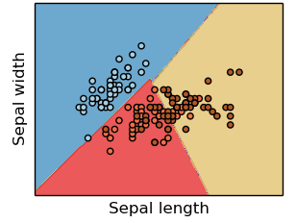
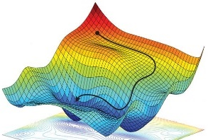


Necessary Components of a Supervised Machine Learning Approach
Training Data
Feature
Selection
Cost Function
Training Algorithm
Model Type
p
s
IrVi
IrSe
Set of labeled samples
Method to select data characteristics critical information
The form of model which will be trained to make decisions
Metric by which a prospective models should be judged
Algorithm to minimize the cost function by tuning model parameters
Description
- Tabular data
- Time-series
- Images
- Videos
- Text samples
- Intuition
- Expert knowledge
- Statistics
- Learned features
- Regression
- Nearest neighbor
- Decision tree
- SVM
- Neural Network
- Squared error
- Absolute error
- Cross-entropy
- Accuracy
- Gradient descent
- Gradient-free opt.
- Analytic solution
Examples
Supervised machine learning approaches require each of these components
* image sources: scikit-learn (for “model type”) and https://reconsider.news/2018/05/09/ai-researchers-allege-machine-learning-alchemy (for “training algorithm”)

Slide 4
Necessary Components of a Supervised Machine Learning Approach
Training Data
Feature
Selection
Cost Function
Training Algorithm
Model Type
p
s
IrVi
IrSe
Set of labeled samples
Method to select data characteristics critical information
The form of model which will be trained to make decisions
Metric by which a prospective models should be judged
Algorithm to minimize the cost function by tuning model parameters
Description
- Tabular data
- Time-series
- Images
- Videos
- Text samples
- Intuition
- Expert knowledge
- Statistics
- Learned features
- Regression
- Nearest neighbor
- Decision tree
- SVM
- Neural Network
- Squared error
- Absolute error
- Cross-entropy
- Accuracy
- Gradient descent
- Gradient-free opt.
- Analytic solution
Examples
Focus
Supervised machine learning approaches require each of these components
* image sources: scikit-learn (for “model type”) and https://reconsider.news/2018/05/09/ai-researchers-allege-machine-learning-alchemy (for “training algorithm”)

Slide 5
Outline
Prediction Models
Error Distribution
Classification Models
Machine Learning
Model Evaluation

Slide 6
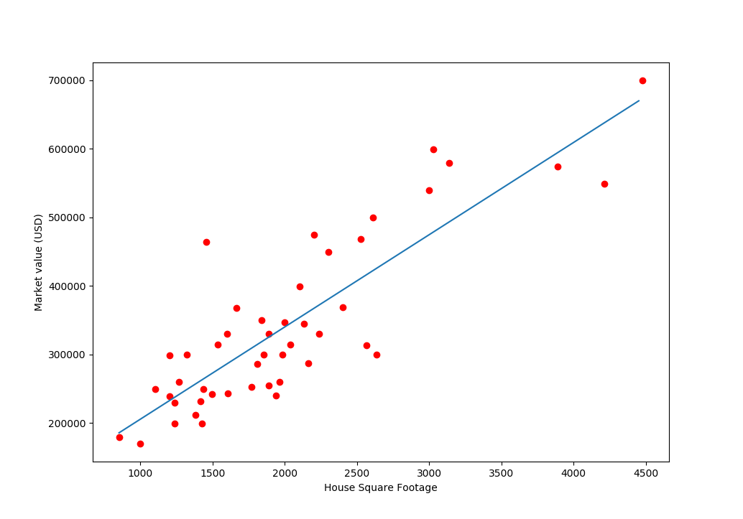
Linear Regression
You are probably familiar with Linear Regression.
In fact, we talked about it in the previous lecture.
Regression is one kind of mathematical model that can be constructed with data.
It allows us to predict values.
House Values with Regression Line

Slide 7
Regression as Predictive Model
In statistics, a predictive model seeks to predict outcomes.
Often, an outcome can be quantified as a data value
We can predict unknown outcomes, even if they’ve already “happened”
Formula for linear regression:
y = mx + b
Regression can predict values for one variable ( y ) from another ( x ).
The main assumption is: every x-value has a y-value, we just may not know it.

Slide 8
Outline
Prediction Models
Error Distribution
Classification Models
Machine Learning
Model Evaluation

Slide 9
Regression and Statistics
Not all data is exactly on the regression line.
In reality, outcomes may not be consistent. Instead, they fit a distribution.
A datum’s vertical distance from the line is called error.
Regression finds the line of best fit that minimizes the total error of data points.
Error

Slide 10
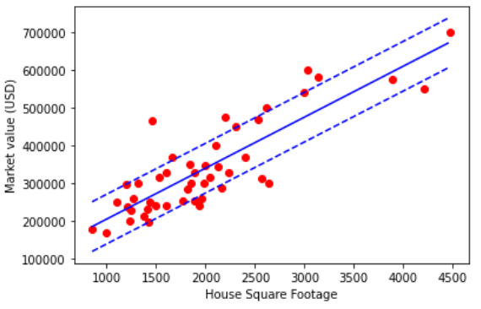
Plotting Error
The amount of error in our data can be used to describe confidence in our predictions.
On the plot on the right, the dashed lines represent the region within 1 standard deviation (𝛔) from the line.
Standard deviation is the square root of variance, which is the average of squared errors.
Standard deviation is not quite the same as average error. Distant point have greater weight, for example.

Slide 11
Outline
Prediction Models
Error Distribution
Classification Models
Machine Learning
Model Evaluation

Slide 12
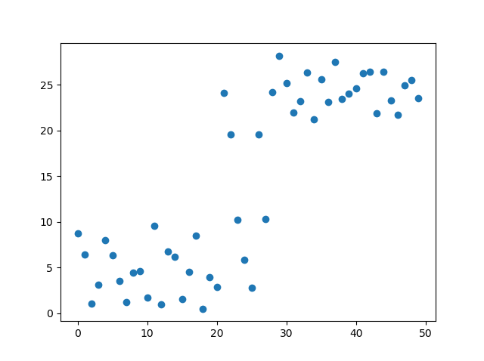
Categorical Variables
Consider the plot to the right. While a regression may not be useful to predict y from x, there is a pattern.

Slide 13
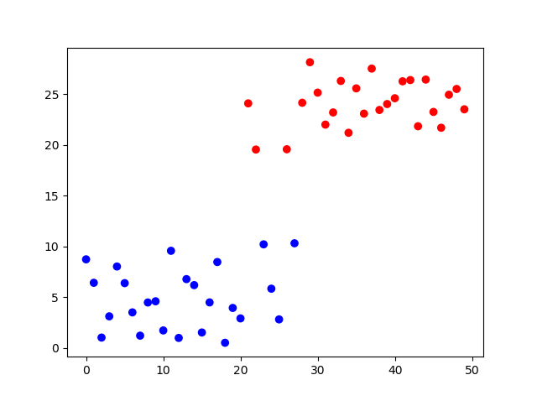
Categorical Variables
Consider the plot to the right. While a regression may not be useful to predict y from x, there is a pattern.
The data can be divided into two groups. We can use color as a third variable that denotes which group the data belongs to. This is called a categorical variable.
Categories can have more than two groups, so long as they are discrete.

Slide 14
Classifiers
Consider a new data point, with both x- and y-values. We can build a model to determine which group (red or blue) it belongs to.
A model for predicting category is called a classifier.
One model that fits our current data could be simply:
if y > 15: red; else blue

Slide 15
Classifiers
Consider a new data point, with both x- and y-values. We can build a model to determine which group (red or blue) it belongs to.
A model for predicting category is called a classifier.
One model that fits our current data could be simply:
if y > 15: red; else blue
How does this model categorize these new points (1 and 2)?
1
2

Slide 16
Decision Trees
Our classifier
if y > 15: red; else blue
is an example of a decision tree.
These models use logical steps (nodes) to determine the final category (leaf).
The paths taken along the tree are called branches.
Decision trees are often shown branching downwards. Perhaps “roots” would have been a better metaphor.
Node:
is y > 15?
YES
NO
RED
BLUE

Slide 17
Nearest Neighbors
Another common approach to classification is nearest neighbors.
This model finds the distance of a new point to known data. The new point is given the classification of its nearest neighbor points.
Consider the green point from before. It’s nearest neighbor is a blue point.
Should we classify this point as blue?

Slide 18
kNN
While the nearest neighbor of our green point is blue, the next two nearest are red.
The most common approach to nearest neighbors is kNN. For this classifier, we choose the most common category from the k-nearest neighbors.
In our example, if k=1, the classification would be blue.
If k=3, it would instead be red.
3
2
1

Slide 19
Outline
Prediction Models
Error Distribution
Classification Models
Machine Learning
Model Evaluation

Slide 20
Machine Learning
Machine learning algorithms are computer programs that improve with use.
One major use of machine learning is to build classification models. By giving the algorithm more pre-categorized (training) data, the model will become increasingly accurate with new (testing) data.
This is called supervised learning, because the data used to build the model has been categorized by a human.
Training Data
Learned Model
Machine Learning Algorithm

Slide 21
Outline
Prediction Models
Error Distribution
Classification Models
Machine Learning
Model Evaluation

Slide 22
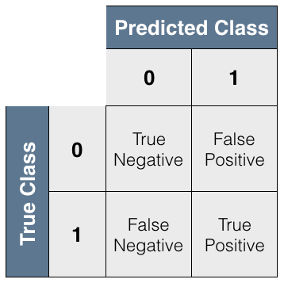
Model Evaluation
Machine learning models can be difficult to interpret. This is one reason it is important to evaluate model performance.
Classification predictions are more complex than “right” or “wrong.” There are actually four possibilities. We should consider the rates of all of these when evaluating a model.
Thought experiment: why would it be a bad idea to simply maximize the rate of true positives?

Slide 23
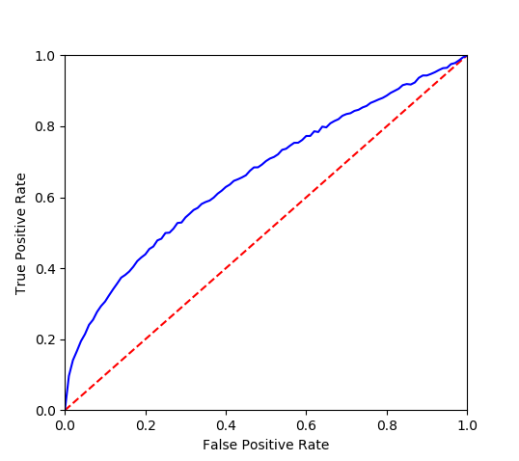
Area Under Curve
A common way to combine true positive rate (TPR, or sensitivity) and false negative rate (FNR, or specificity) is the receiver operating characteristic (ROC).
On a ROC curve, we plot TPR against the false positive rate (FPR), which must be equal to 1 - FNR.
Metrics of accuracy include the area under the ROC curve, and the area between the ROC and the diagonal from (0,0) to (1,1).
ROC Curve
Naive Predictor

Slide 24
Summary
Mathematical models can be used to make predictions about data
In many cases, we can use statistics to predict a distribution of values
Classifiers are models that predict categories for data
Decision trees and kNN are common classifiers
Machine learning algorithms can build classifiers from training data
Models need to be evaluated by metrics that combine both sensitivity and specificity

